Slide 1
SOEN-6011
PROJECT ETERNITY
DELIVERABLE -1
JAIWANT SINGH MAHUN
40270569
Wednesday, July 10, 2024

Slide 2

Transcendental Function
F4 (Gamma Function) : Γ(x)
DEFINITION
A gamma function, represented by Γ(x) , is an extension of factorial function to non integers and complex numbers. It can be represented in 2 ways :
For positive integers, it can be represented as :
Γ(z) = (z-1)! for z ∈ Z+
For any real number > 0, gamma function can be represented as:
where, z is a complex number and real part is strictly positive (Re(z)>0)
PG 2.

Slide 3
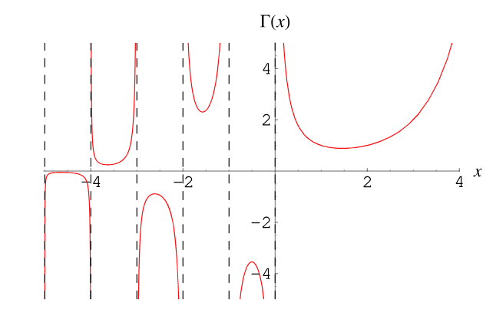
Domain
Γ(z) is defined for all complex number z where, z is not a non-positive integer.
Co-Domain
Γ(z) function can produce all complex numbers except non-positive integers, where function is non defined.
Plot Representation
PG 3.
[1] Plot of Gamma function

Slide 4
ASSUMPTIONS
Γ(z) is defined for all complex number z where, z is not a non-positive integer also called poles where the function is undefined.
Assumes that the methods used to compute gamma values are stable for the specified range they are used for.
Assumes that computational libraries/ programming languages will be able to support very large values along with high precision.
Eg : BigDecimal in Java.
For practical computations, certain approximations or rounding offs can be made for tradeoffs between computation speed and precision.
Gamma function is continuous and differentiable for positive real numbers.
PG 4.

Slide 5
REQUIREMENTS
ID : GAMMA-REQ-001
Title : Function Domain
Description : Γ(z) is defined for all complex number z where,
z is not a non-positive integer.
Stakeholder Priority : High
Rationale : Ensures that the function is applicable to range of value.
Difficulty : Nominal
Type : Functional
Assumption : z is a real number.
ID : GAMMA-REQ-002
Title : Function Equation
Description : Γ(z) must satisfy : Γ(z) = (z-1) Γ(z-1) for Re(z)>0
Stakeholder Priority : High
Rationale : The equation is recursive property of Gamma functions
Difficulty : Nominal
Type : Functional
Assumption : z is a positive real number.
PG 5.

Slide 6
ID : GAMMA-REQ-003
Title : Function Equation for positive integers
Description : For any positive integer z,
Γ(z) shall satisfy : Γ(z) = (z-1)! , z ∈ Z+
Stakeholder Priority : High
Rationale : Ensures function is consistent for positive integers.
Difficulty : Nominal
Type : Functional
Assumption : z is a positive integer.
ID : GAMMA-REQ-004
Title : Function Continuity
Description : For positive real numbers, Γ(z) is continuous and
convex function.
Stakeholder Priority : Medium
Rationale : Ensures function is continuous and differentiable for values
greater than 0.
Difficulty : Nominal
Type : Functional
Assumption : z is a positive real number.
PG 6.

Slide 7

ID : GAMMA-REQ-005
Title : Euler Infinite Product
Description : For any real number z except non positive integers,
Γ(z) satisfies :
Stakeholder Priority : Medium
Rationale : Efficient estimate of complex number z including
negative real numbers except non positive integers.
Difficulty : Nominal
Type : Functional
Assumption: For practical computation, n is taken as a large no. (80k)
and z is any real number except non positive integers.
ID : GAMMA-REQ-006
Title : Computation Efficiency
Description : For computational efficiency, the results
computation should be fast and be precise.
Stakeholder Priority : Medium
Rationale : Efficient computation of gamma value.
Difficulty : Nominal
Type : Non Functional
PG 7.

Slide 8
REFERENCES
[1] https://mathworld.wolfram.com/GammaFunction.html
[2] https://en.wikipedia.org/wiki/Gamma_function
[3]https://math.libretexts.org/Bookshelves/Analysis/Complex_Variables_with_Applications_(Orloff)/14%3A_Analytic_Continuation_and_the_Gamma_Function/14.02%3A_Definition_and_properties_of_the_Gamma_function
[4]https://en.wikipedia.org/wiki/Stirling%27s_approximation
[5]https://www.roma1.infn.it/~bonvini/math/Marco_Bonvini__Gamma_function.pdf
PG 8.

